Slide 1
San Jose State University Center for the Development of Recycling Vermiculture: The Essence of Composting at Home

Slide 2
History of Compost
Compost dates back to the Roman Empire
Modernized in the 1920’s when Rudolf Steiner found that it was useful for farming
Considered “humus” until it was found to be insoluble in water
Since then, many large and small-scale methods using compost for fertilization have been practiced
opschools.org
http://www.partselect.com/JustForFun/A-Home-Guide-To-Composting.aspx

Slide 3
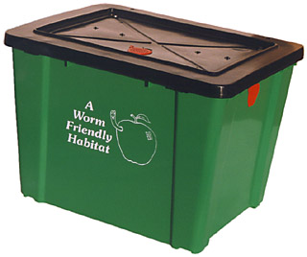
Overview and Benefits
Learn details of worm composting
Practice home composting
Build a bin made either
out of wood or plastic
Divert waste from the landfill
homecompostingmadeeasy.com

Slide 4
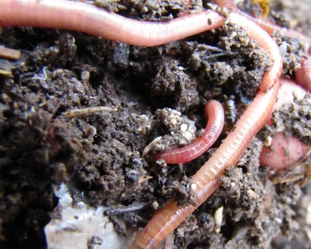
Vermiculture Composting:
Worms produce droppings known as castings.
Castings
Generate the best soil amendment known in horticulture
Provide nutrients that stimulate plant growth due to chemicals, fungi and bacteria located in the worm’s gut
waldeneffect.org
http://www.calrecycle.ca.gov/organics/worms/

Slide 5
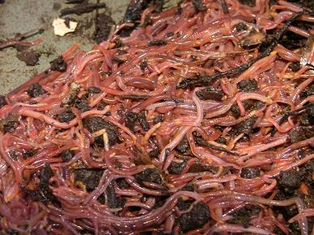
Get to Know Your Worms
Red Wigglers (Eisenia foetida or Lumbricus rubellus ) are used for vermiculture composting
Surface dwellers
Can eat half of their weight each day
Can double population in 2 months
Dew-worms (large worms), may not survive vermiculture
northwestredworms.com
http://www.cityfarmer.org/wormcomp61.html#wormcompost

Slide 6
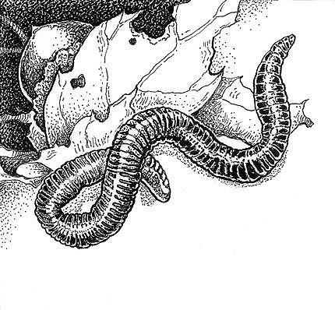
Worms Con’t
Worms are light sensitive
Temp: Keep within 50-60
degrees Fahrenheit
Worms die at 80 degrees
Fahrenheit
Air: Worms breathe
through skin
Loosely pack compost
Water: Worms like moist compost
About 75% water
pacifichorticulture.org
Michele Young - Environmental Services Director, City of San Jose

Slide 7
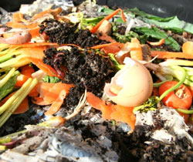
How Many Red Wigglers?
2,000 worms (~ 2 lbs.) can compost one pound of food waste
blog.gardenharvestsupply.com
Under the right conditions, worms quickly multiply to 3,000
Start with fewer worms, reduce the amount of food waste to allow the worm population to increase at a steady pace.
http://www.cityfarmer.org/wormcomp61.html#wormcompost; http://www.calrecycle.ca.gov/organics/worms/WormFact.htm#09

Slide 8
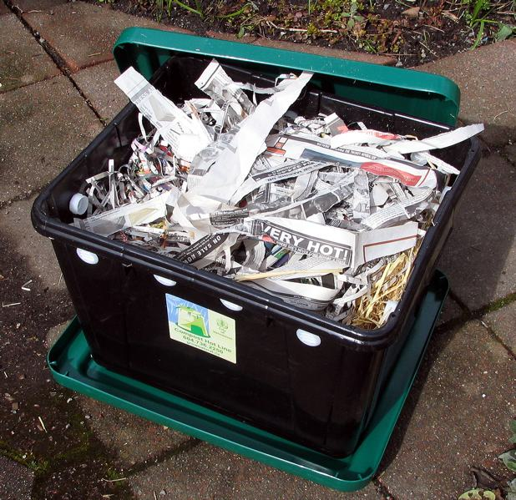
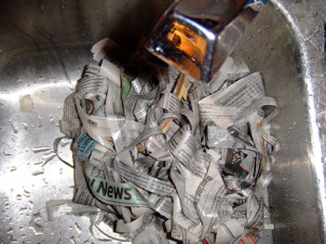
Step by Step: The Worm Bed
1) Rip apart black and white newspapers into one inch wide strips
2) Plump up the newspapers and then moisten the compost, but make sure it is not drippy
http://homepage.mac.com/cityfarmer/comiclife/
http://reducewaste.org/portal/site/iwm/
abloomgardencenter.com

Slide 9
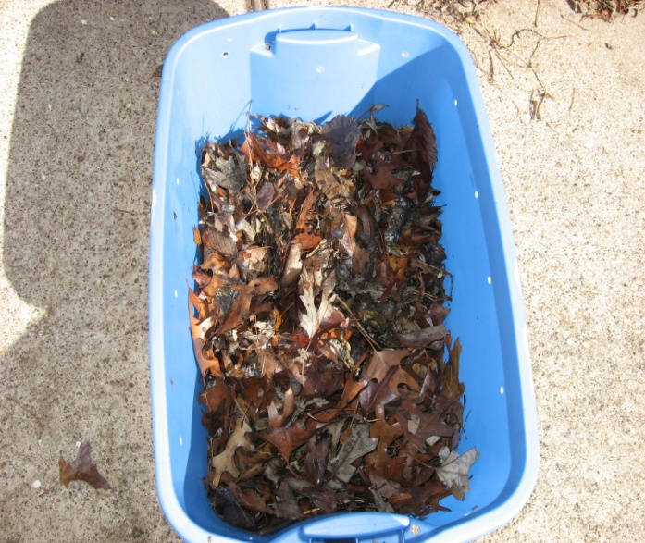
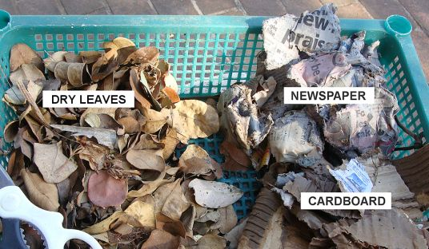
The Worm Bed (Con’t)
3) Fill ¾ of bin with the following bedding materials: shredded corrugated cardboard, shredded leaves, compost, aged manure, sawdust and chopped up straw, but NO glossy paper or magazines
4) A few handfuls of soil and/or sand need to be placed on the bedding for effective grit digestion of the worm
txwormranch.com
http://reducewaste.org/portal/site/iwm/
vermicomposters.ning.com

Slide 10
Adding Worms
http://www.redwormcomposting.com/
5) Dig to the middle layer, put worms in, and then cover them up
You can find Red Wigglers at bait shops or through the Internet. The price for a pound of worms is about $15 to $20
http://reducewaste.org/portal/site/iwm/

Slide 11
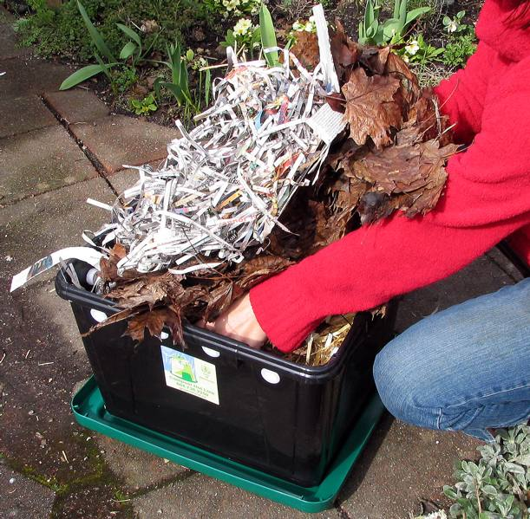
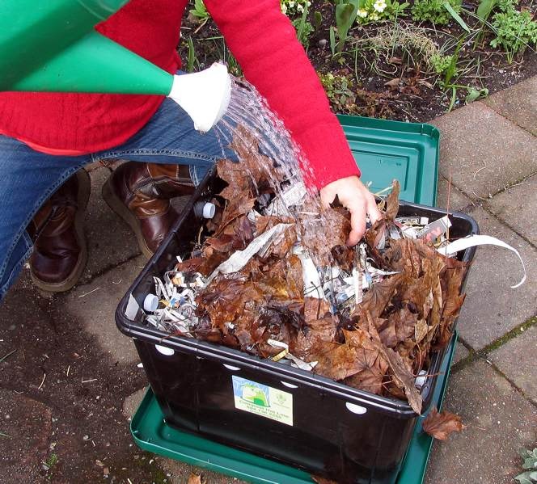
Bedding Care
Lift bedding for aeration to prevent or reduce odors
If bedding is too dry, add water
Replace bin with fresh bedding every one to three months
At all times, keep a four to six inch layer of fresh bedding on top of the worms and food in your bin
http://homepage.mac.com/cityfarmer/comiclife/
http://reducewaste.org/portal/site/iwm/

Slide 12
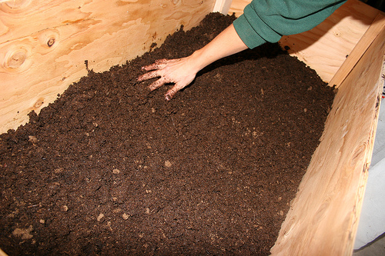
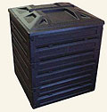
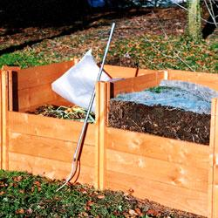
Replacing Bedding
A new four to six inch layer of bedding should be added every one to three months
“Should be moist as a wrung-out sponge”
For plastic bins, add more bedding for the absorption of excess moisture
For wooden bins, add more water for the lack of moisture
wigglingaround.com
http://reducewaste.org/portal/site/iwm/
cityofdavis.org
allthingsgreen.net

Slide 13
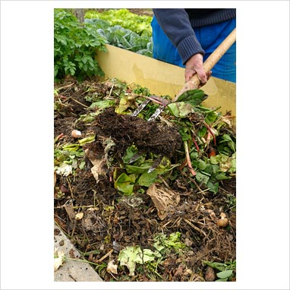
Step by Step: Feeding
1. CHOP materials if you want them to break down more quickly
2. MIX "browns" (dry, woody materials) with "greens" (moist, green materials)
gapphotos.com
http://reducewaste.org/portal/site/iwm/

Slide 14
Do’s and Don’ts
waste-invaders.co.uk

Slide 15
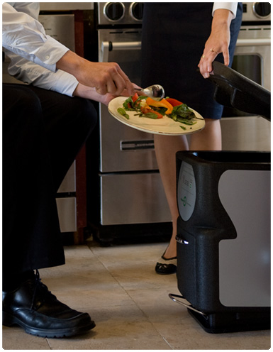
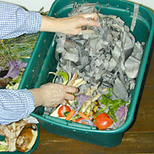
First Time Feeding
Microwave food before putting into bins (3-5 min) to kill larvae of any kind
Feed worms about one quart or one pound of food and leave the worms alone for about two week prior to feeding again
After two weeks, feed the worms the same amount except once a week at your schedule
keetsa.com
Michele Young - Environmental Services Director, City of San Jose
leaveitbetter.com

Slide 16
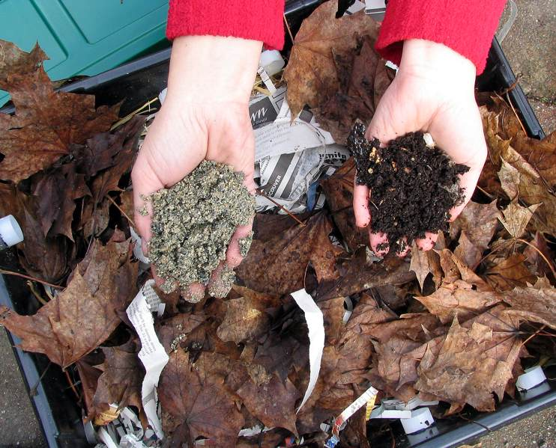
Harvesting
Worm compost should
be harvested at least
once on an annual
basis
Harvesting may begin
two to three months after
worm bin set up
You can scoop up the contents of the compost bin and collect the brown crumbly compost
http://homepage.mac.com/cityfarmer/comiclife/
http://reducewaste.org/portal/site/iwm/

Slide 17
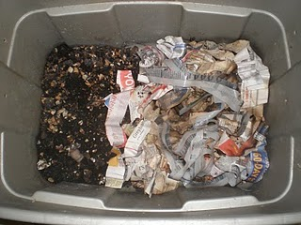
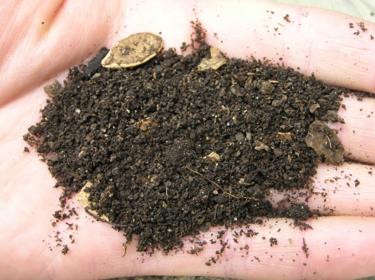
Harvesting Con’t
Another method would be to move all contents on one side and place new bedding with a handful of soil and food in the empty side
The worms will migrate from the composted side to the side with new bedding and food in due time
aagaardfarms.blogspot.com
http://reducewaste.org/portal/site/iwm/
vermicultureafrica.co.za

Slide 18
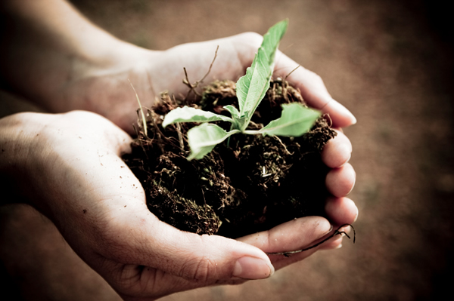
Compost and Gardening
Using Worm Compost will help your plants thrive by adding nutrients and humus to the soil. Sprinkle a 1/4" to 1" layer at the base
of indoor or
outdoor plants,
or blend no more
than 20% worm
compost into
potting mix or
garden soil
sheknows.com
http://reducewaste.org/portal/site/iwm/

Slide 19
Troubleshooting
SYMPTOM | PROBLEM | SOLUTION
The compost has a bad odor. | Not enough air in the pile. | Turn the pile, add dry material if the pile is too wet.
The center of the pile is dry. | Not enough water in the pile. | Moisten and turn the pile.
The compost is damp and warm only in the middle. | The pile is too small. | Add more material and mix it all into a new pile.
The pile is damp and sweet smelling but will not heat up. | Not enough nitrogen in the pile. | Mix in a nitrogen source like fresh grass clippings or manure.

Slide 20
Making Bins
You can buy compost bins at Home Improvement Stores (Home Deport, Lowes, True Value, and on-line.
Visit the Center for Development of Recycling website to find out how to make your own plastic or wooden compost bins!

